Slide 2
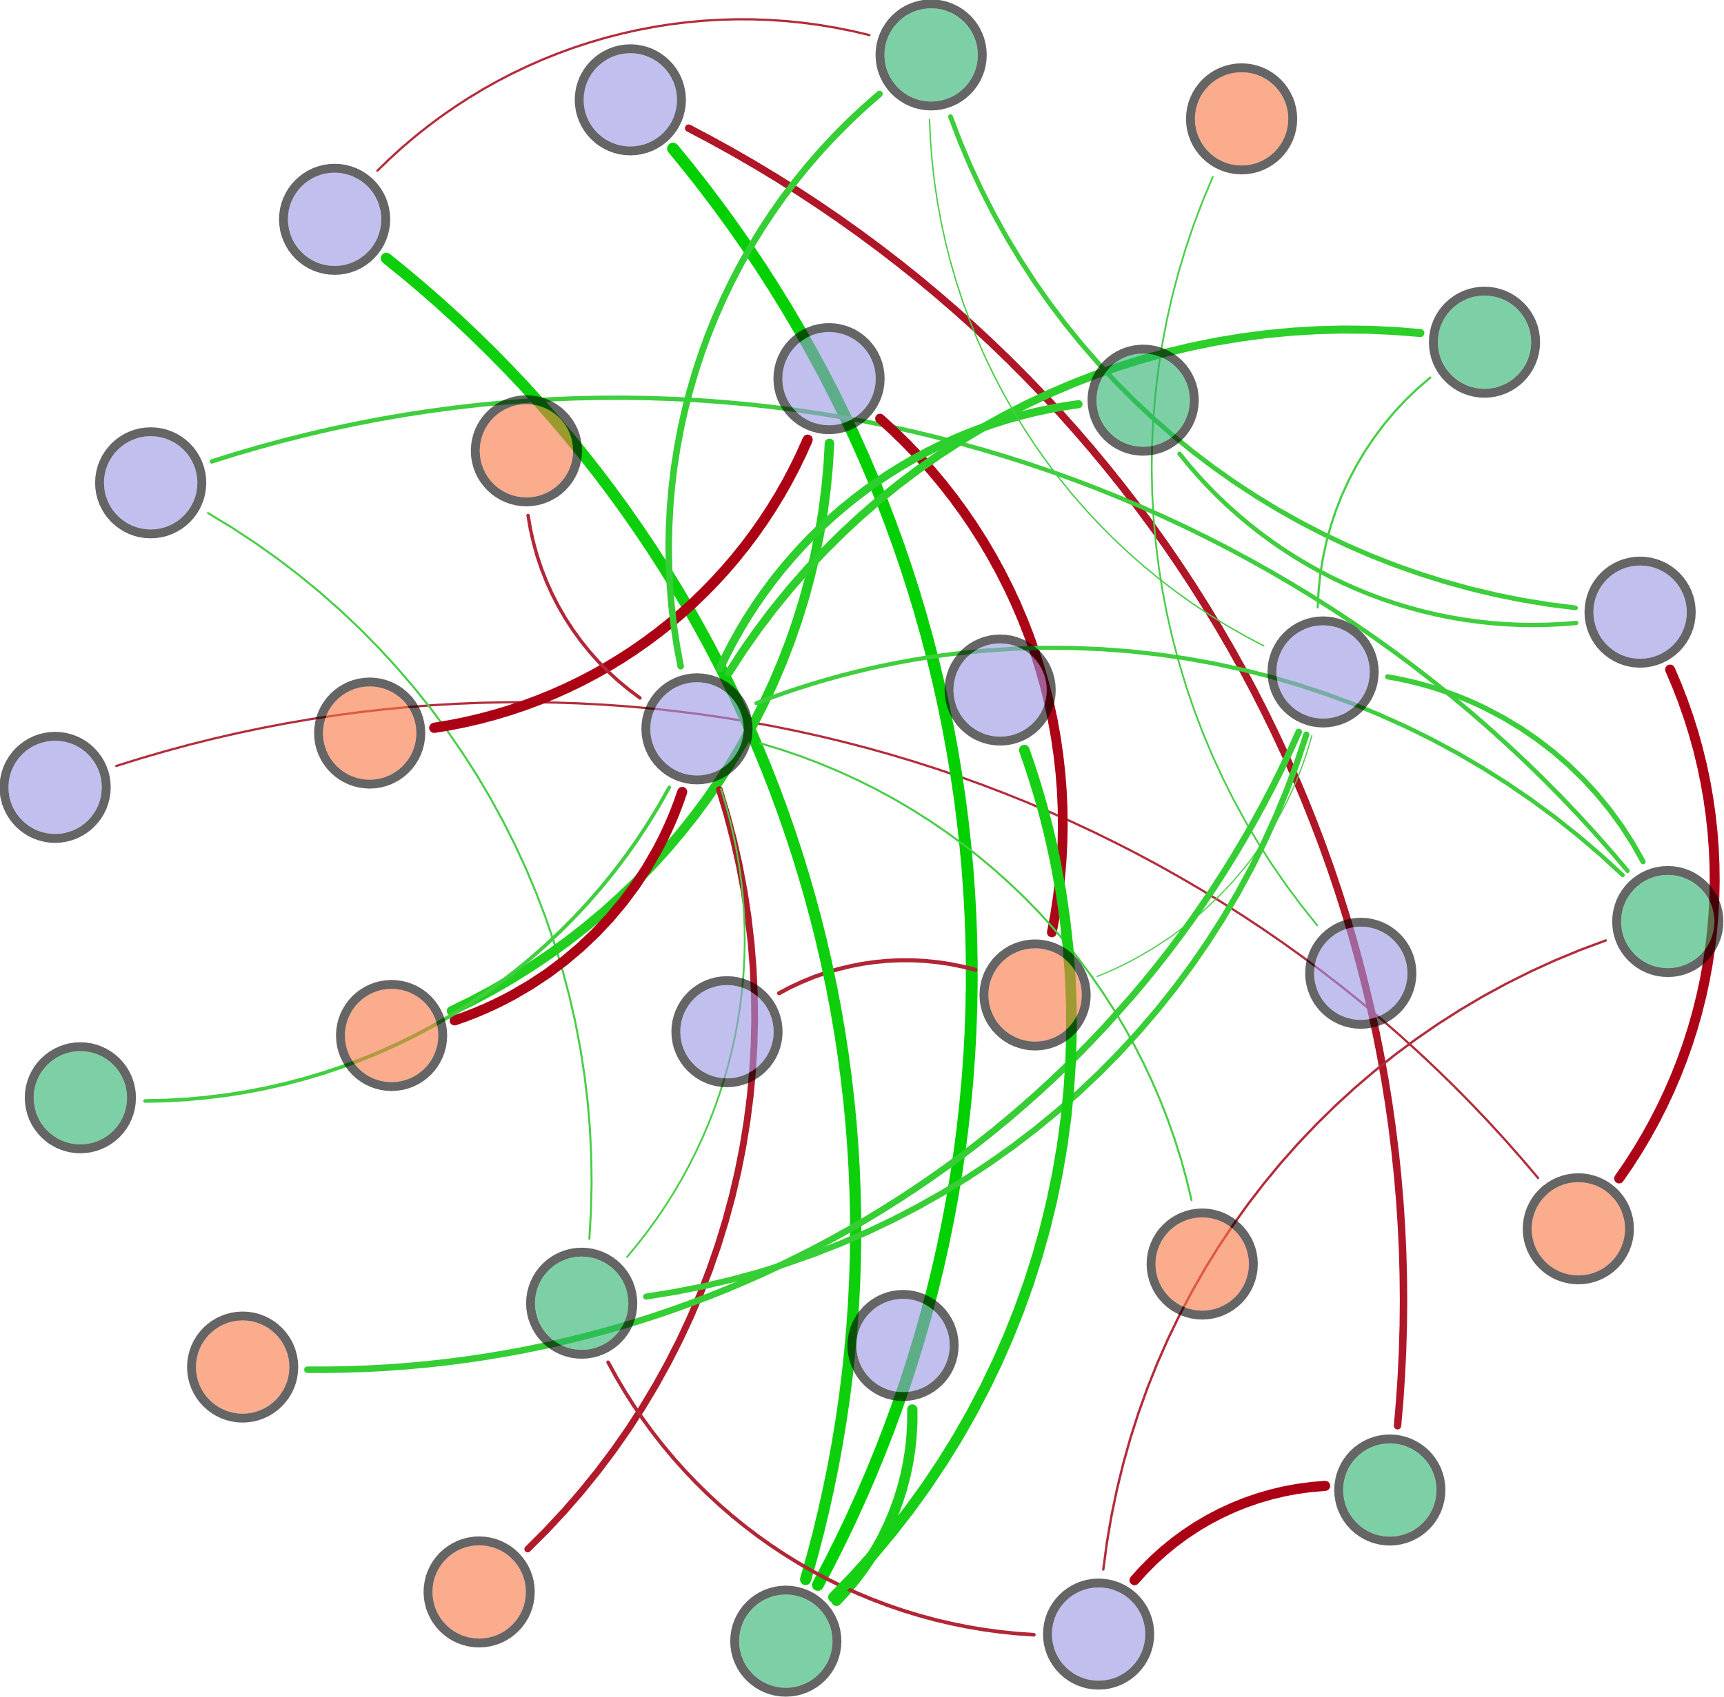
W-TN
AOA_amoA
Ⅳ-Area
nirK
norB
Ⅲ-Area
narG
Archaeal 16S rRNA
nifH
hzsB
S-TN
hzsA
Bacterial 16S rRNA
T
Ⅰ-Area
AOB_amoA
HIX
napA
TP
DO
FI
Ⅱ-Area
nosZ
COD
Ⅴ-Area
pH
hzo

Slide 3
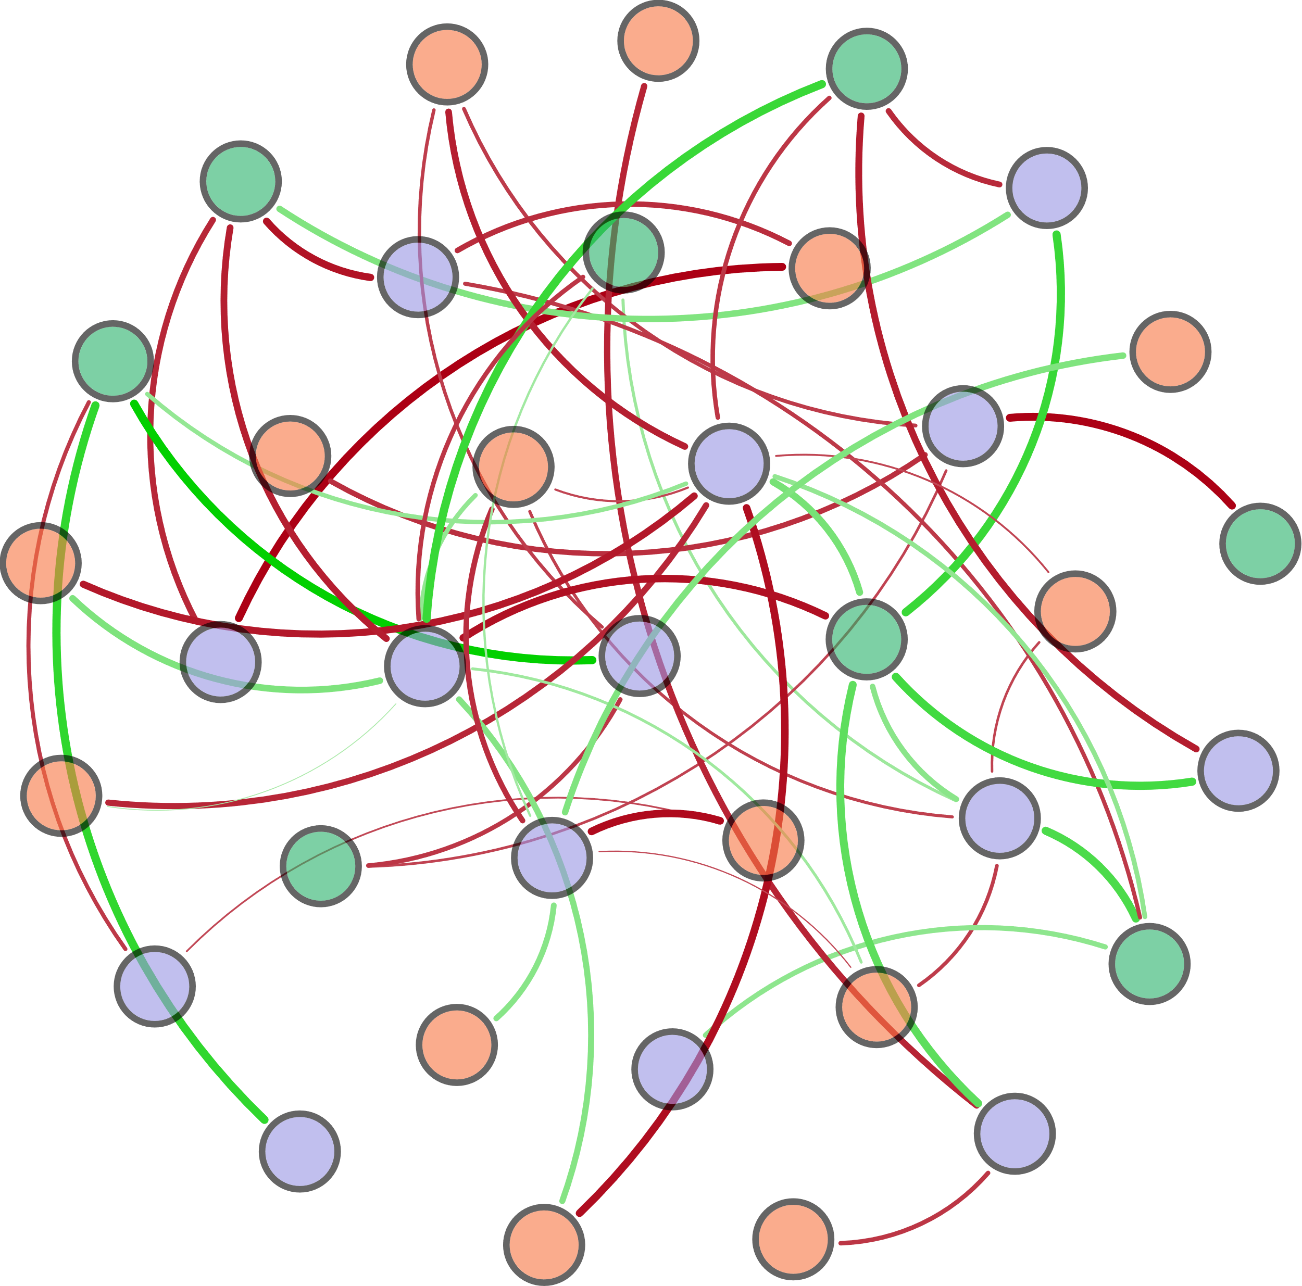
(d_{0.9}-d_{0.1})/d_{0.5}
Ⅴ-Area
DO
nirS
nirK
W-TN
S-TN
COD
BIX
nxrA
HIX
d_{0.9}
hzsB
Ⅱ-Area
TP
Bacterial 16S rRNA
hzo
norB
hzsA
Ⅰ-Area
Archaeal 16S rRNA
d_{0.1}
T
nifH
AOA_amoA
pH
d_{0.5}
β:α
narG
AOB_amoA
napA
Ⅳ-Area
Ⅲ-Area

Slide 4
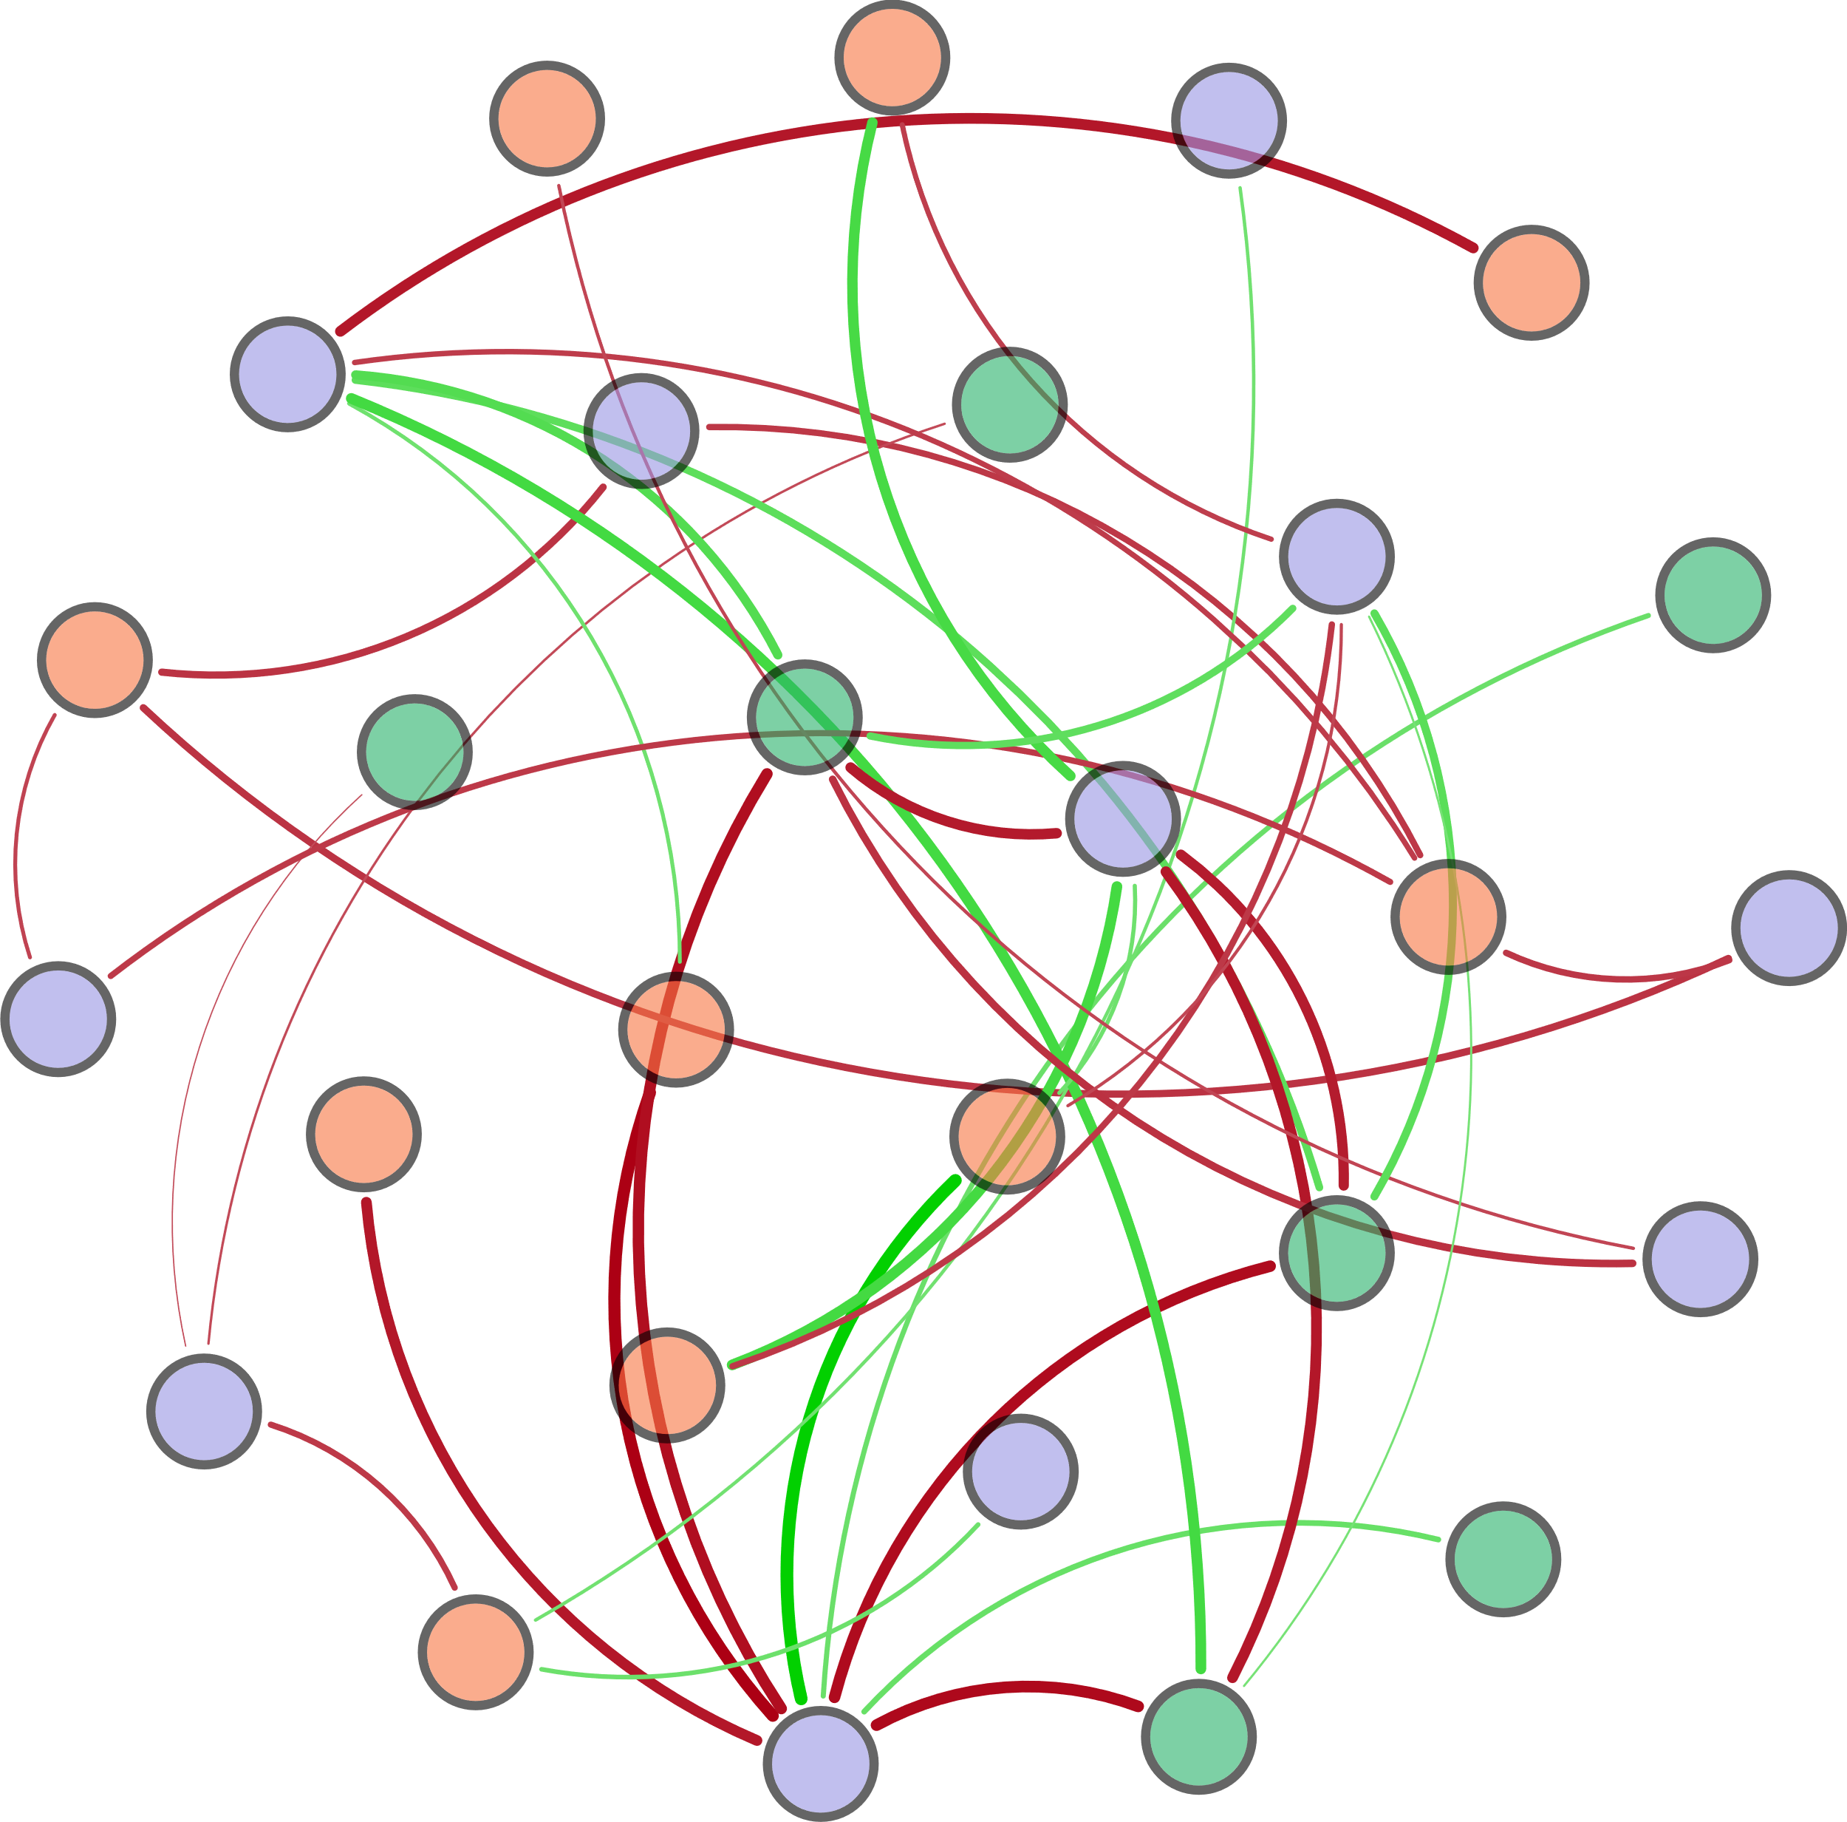
d_{0.9}
S-TN
narG
S-TP
napA
Archaeal 16S rRNA
hzo
Ⅲ-Area
COD
DO
norB
Ⅴ-Area
AOA_amoA
nirK
Ⅰ-Area
Ⅳ-Area
HIX
pH
hzsA
nxrA
d_{0.5}
nifH
W-TN
FI
Bacterial 16S rRNA
T

Slide 6
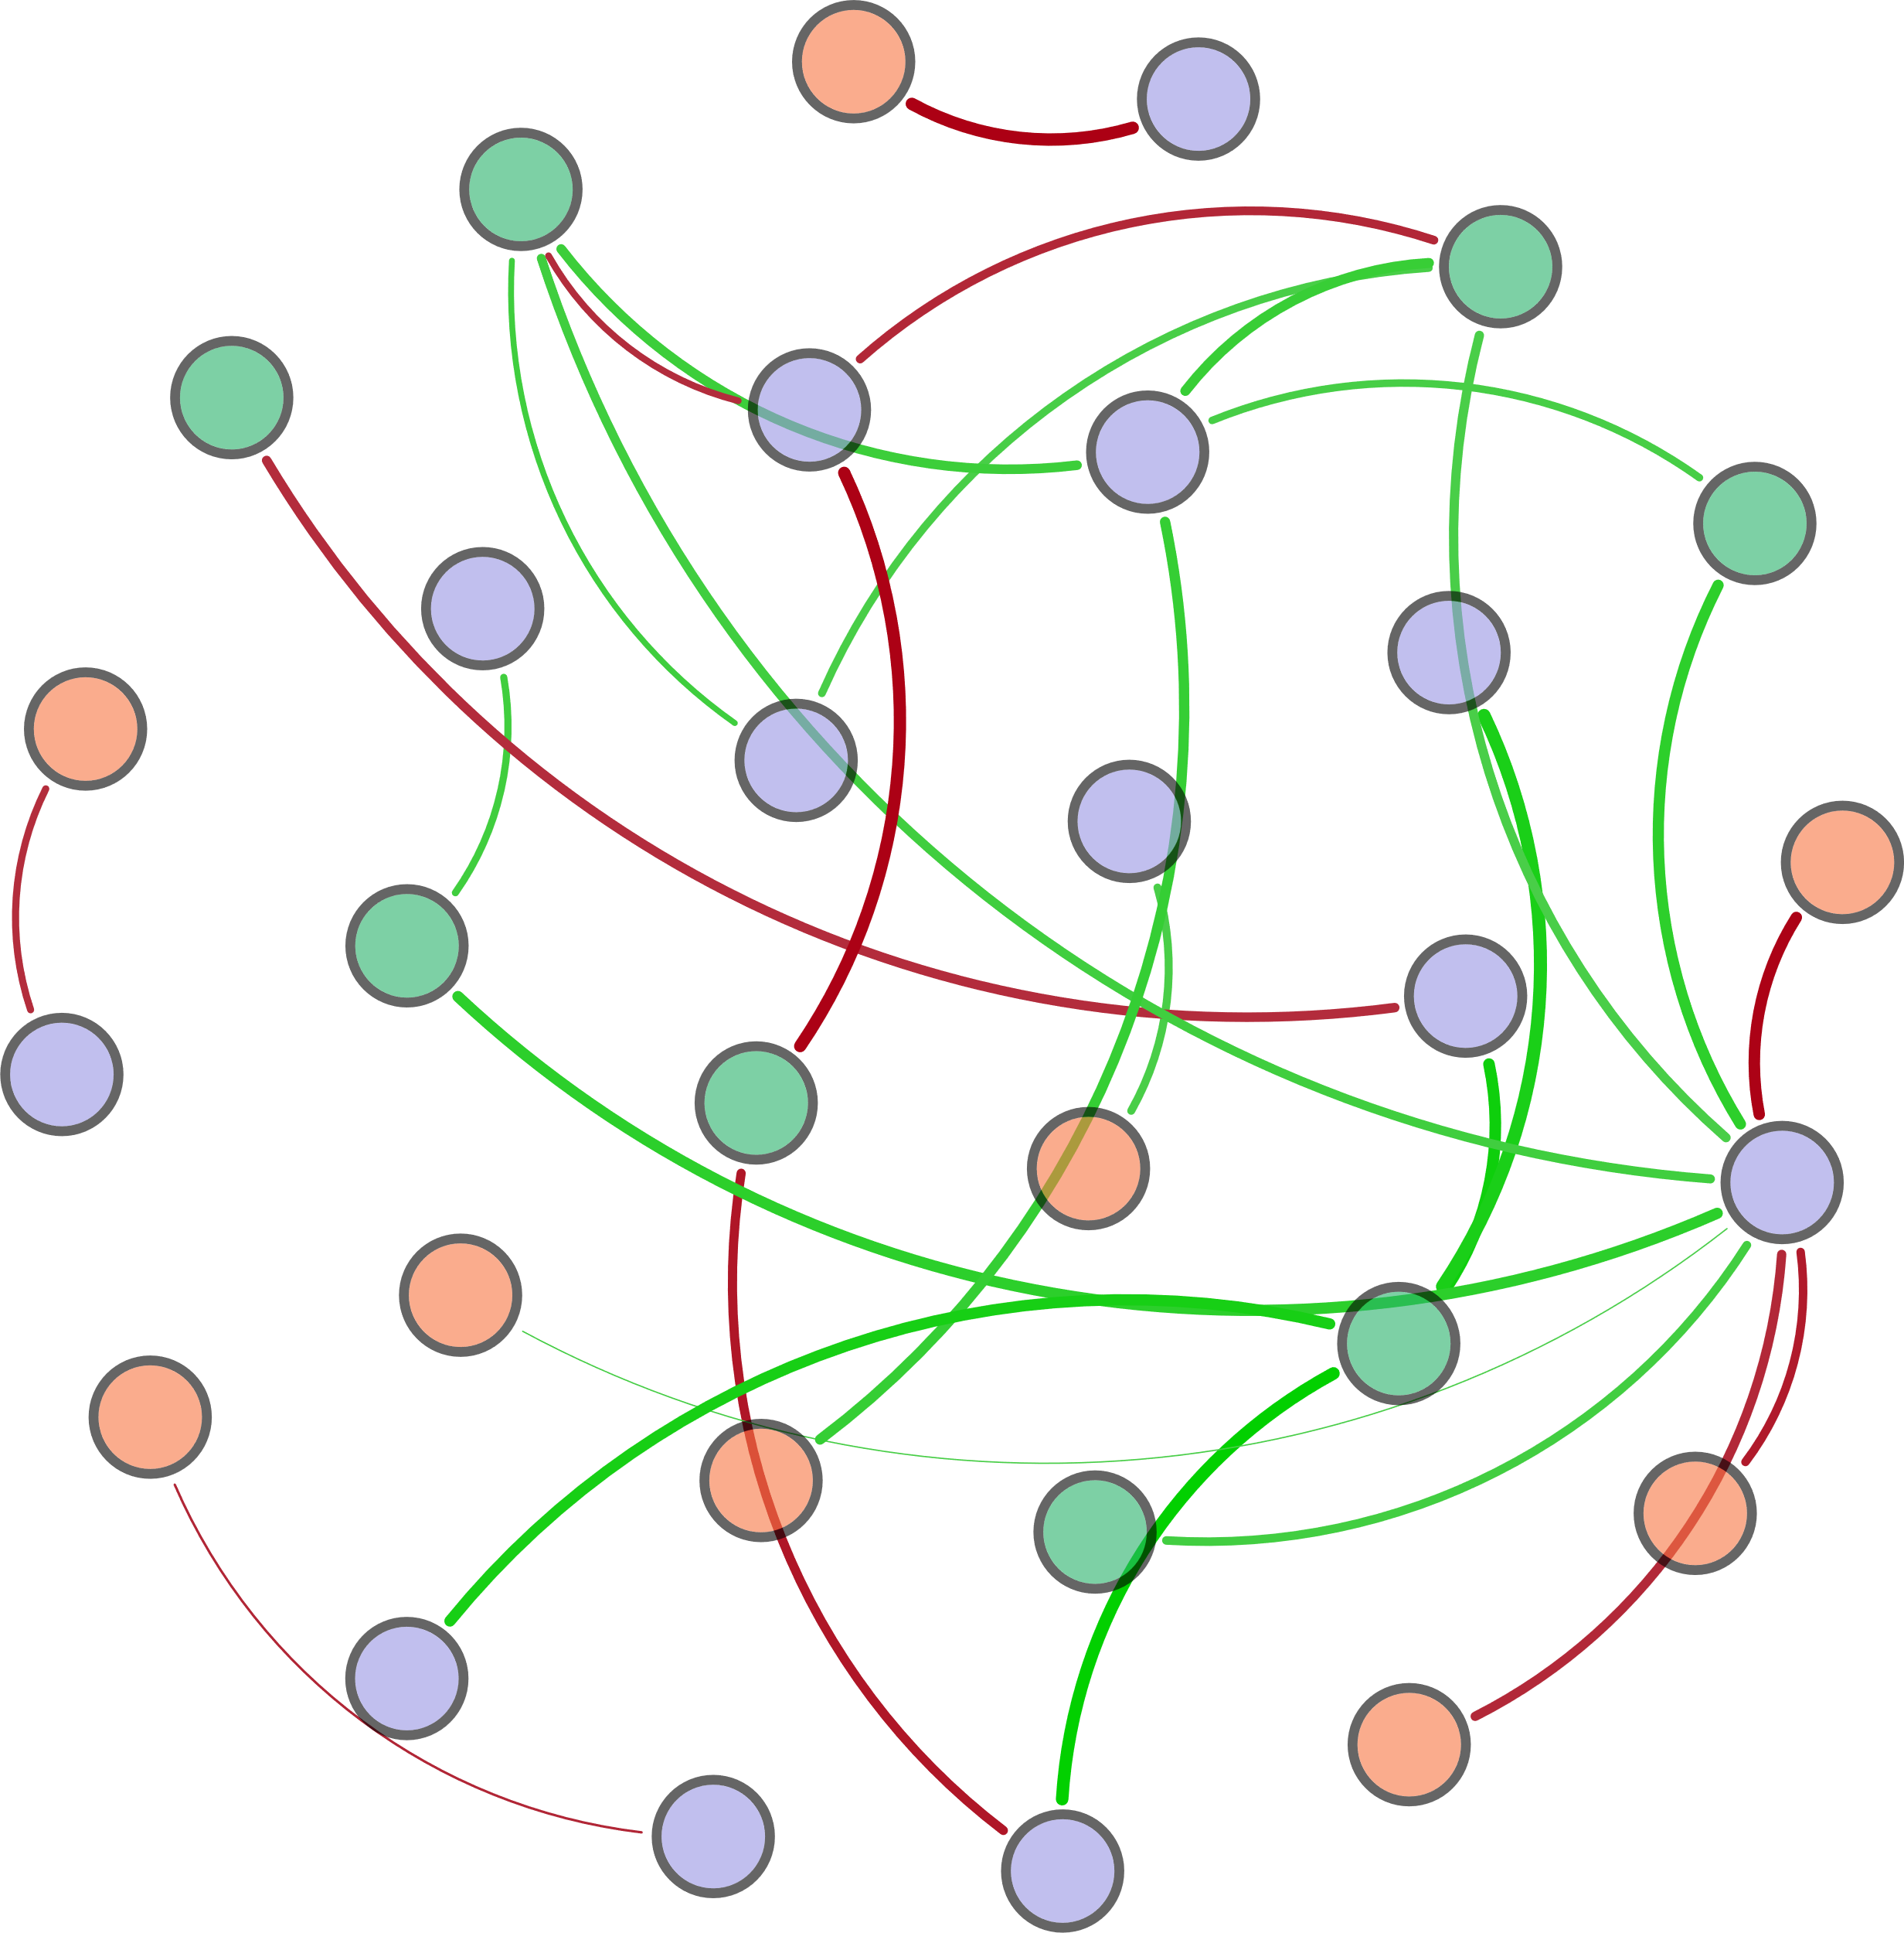
S-TN
norB
T
DO
W-TN
hzo
hzsB
Archaeal 16S rRNA
nosZ
TP
narG
AOB_amoA
HIX
nirK
Bacterial 16S rRNA
COD
Ⅳ-Area
hzsA
FI
pH
Ⅰ-Area
Ⅱ-Area
Ⅴ-Area
nifH
Ⅲ-Area
napA
AOA_amoA

Slide 7
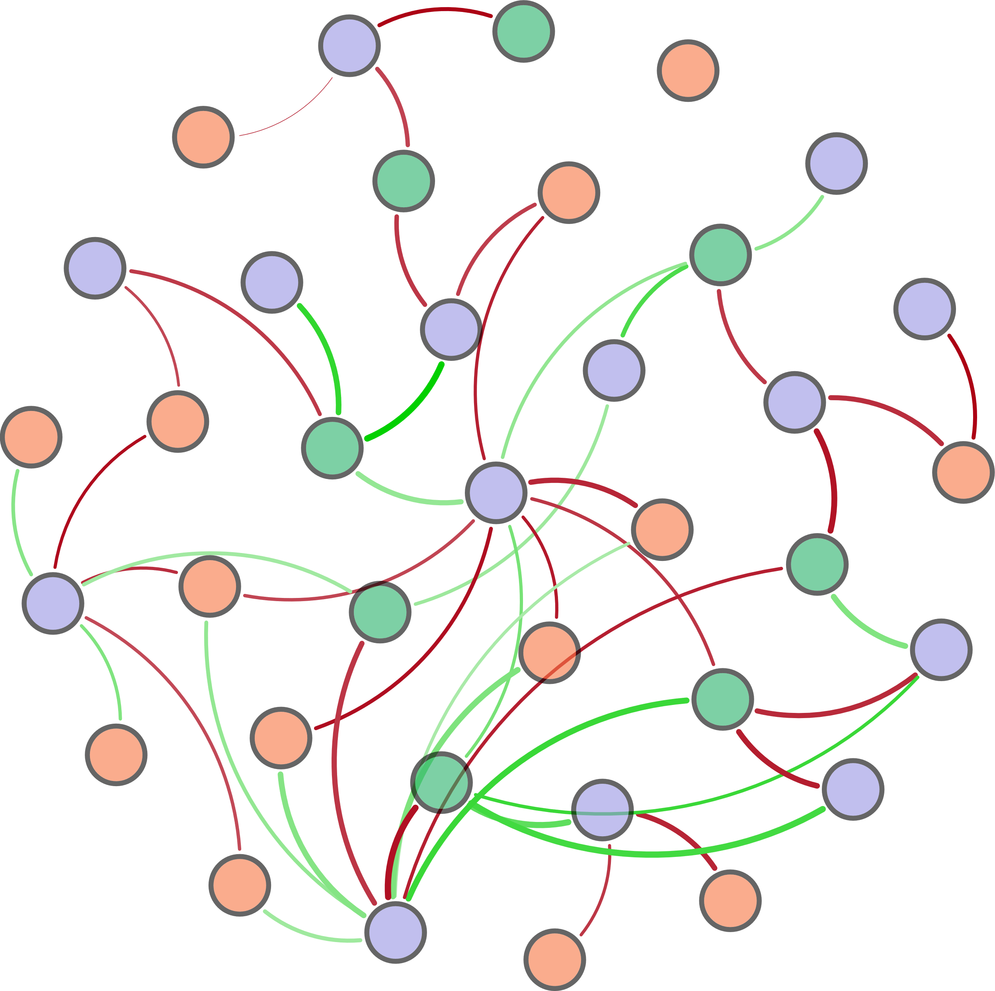
nxrA
TP
HIX
T
narG
(d_{0.9}-d_{0.1})/d_{0.5}
AOA_amoA
pH
AOB_amoA
Bacterial 16S rRNA
norB
Archaeal 16S rRNA
d_{0.1}
nirK
β:α
COD
hzsB
S-TN
Ⅰ-Area
nifH
d_{0.9}
W-TN
Ⅱ-Area
nirS
DO
BIX
Ⅳ-Area
hzsA
napA
d_{0.5}
Ⅴ-Area
hzo
Ⅲ-Area

Slide 8
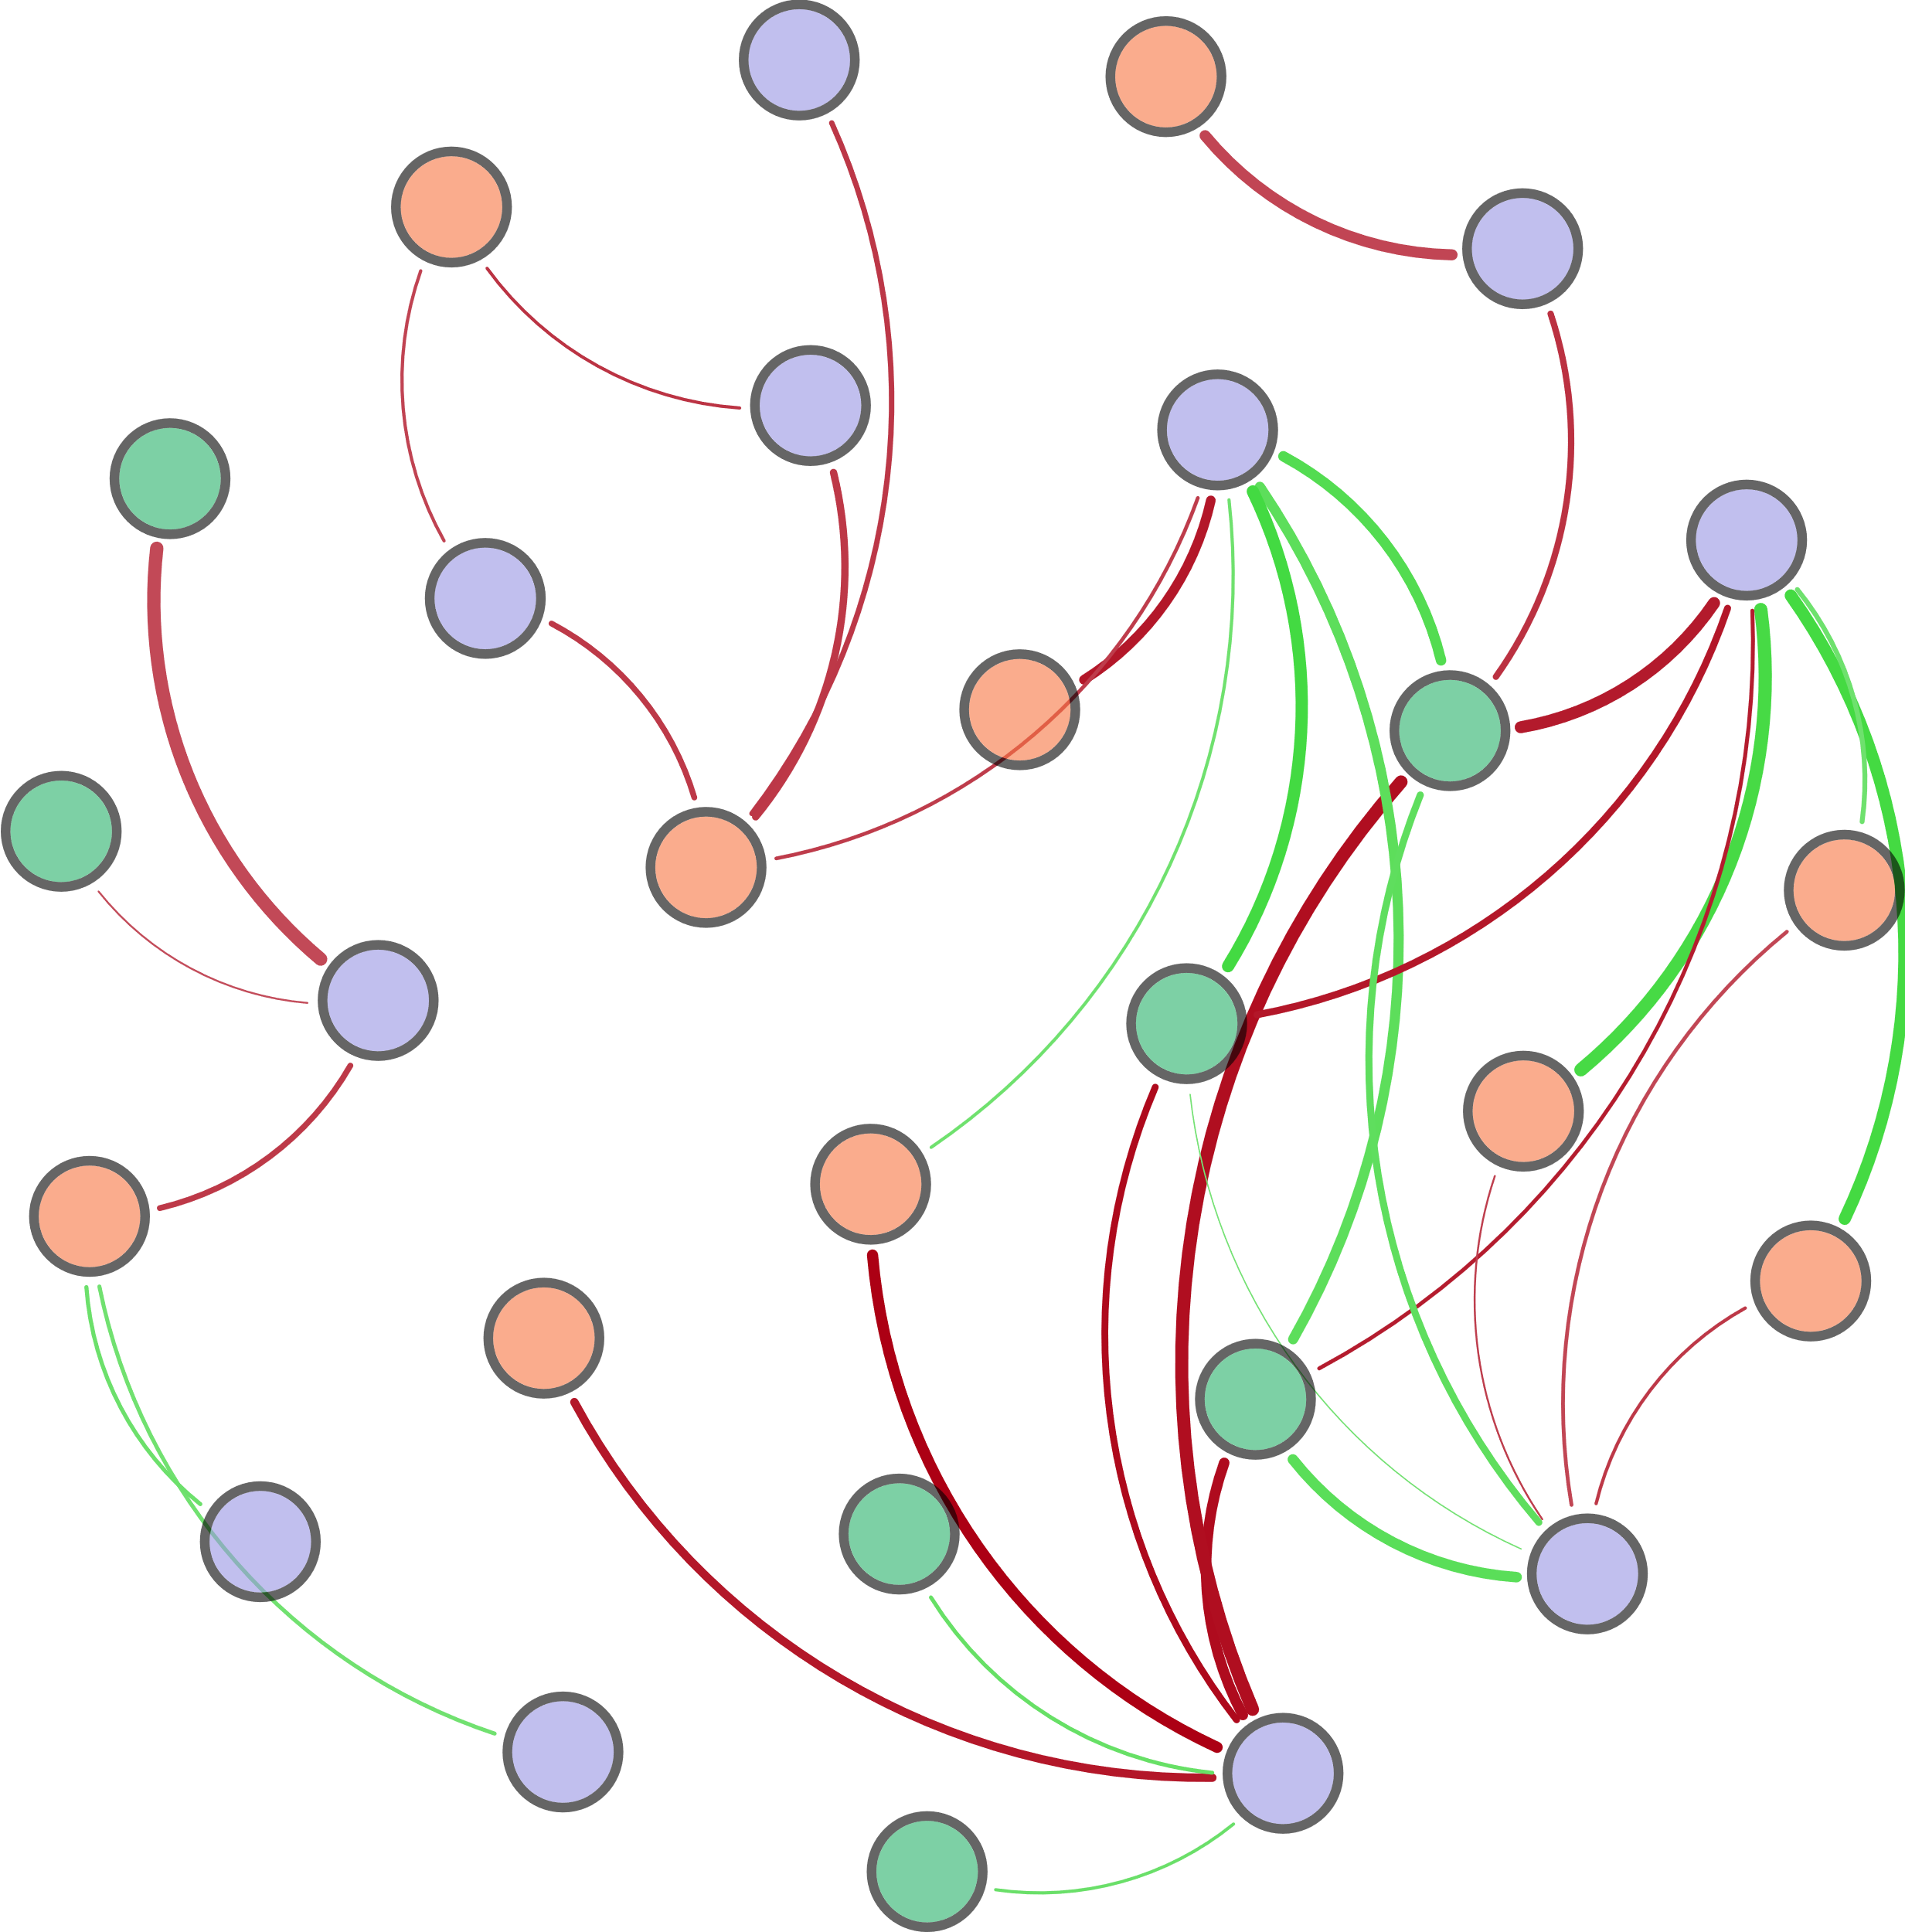
AOA_amoA
S-TN
Ⅲ-Area
hzsA
Archaeal 16S rRNA
napA
norB
nirK
TP
DO
COD
Ⅴ-Area
HIX
nxrA
T
d_{0.9}
FI
Ⅰ-Area
d_{0.5}
Ⅳ-Area
pH
nifH
W-TN
hzo
narG
Bacterial 16S rRNA

Slide 10
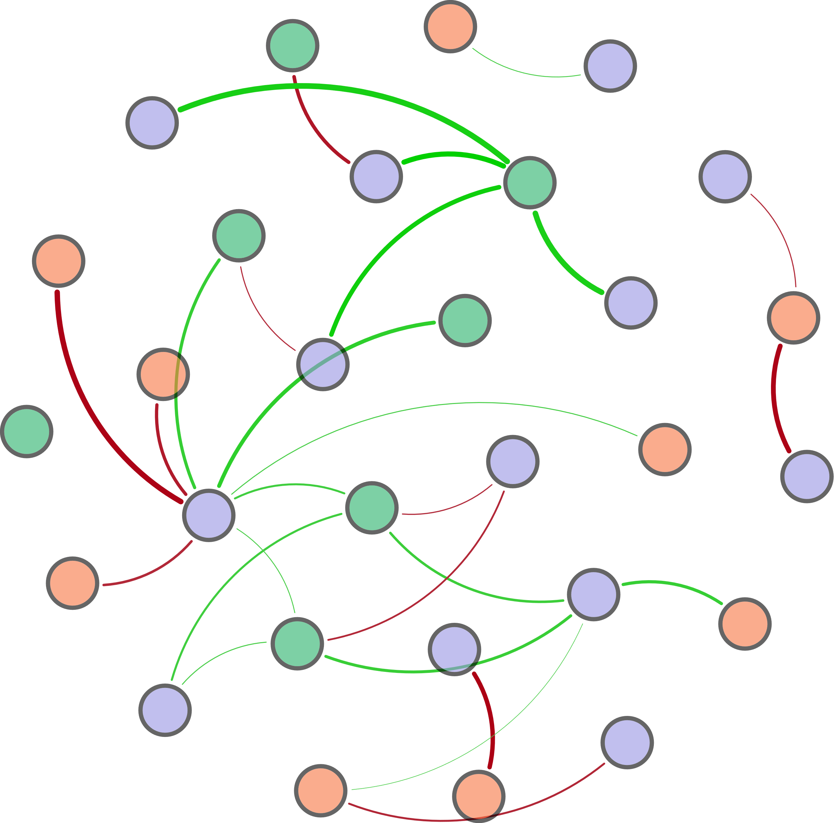
Ⅳ-Area
COD
AOB_amoA
nifH
AOA_amoA
pH
Bacterial 16S rRNA
W-TN
HIX
nosZ
TP
Ⅴ-Area
nirK
hzo
FI
Archaeal 16S rRNA
hzsA
T
Ⅲ-Area
hzsB
Ⅱ-Area
DO
norB
narG
napA
Ⅰ-Area
S-TN

Slide 11
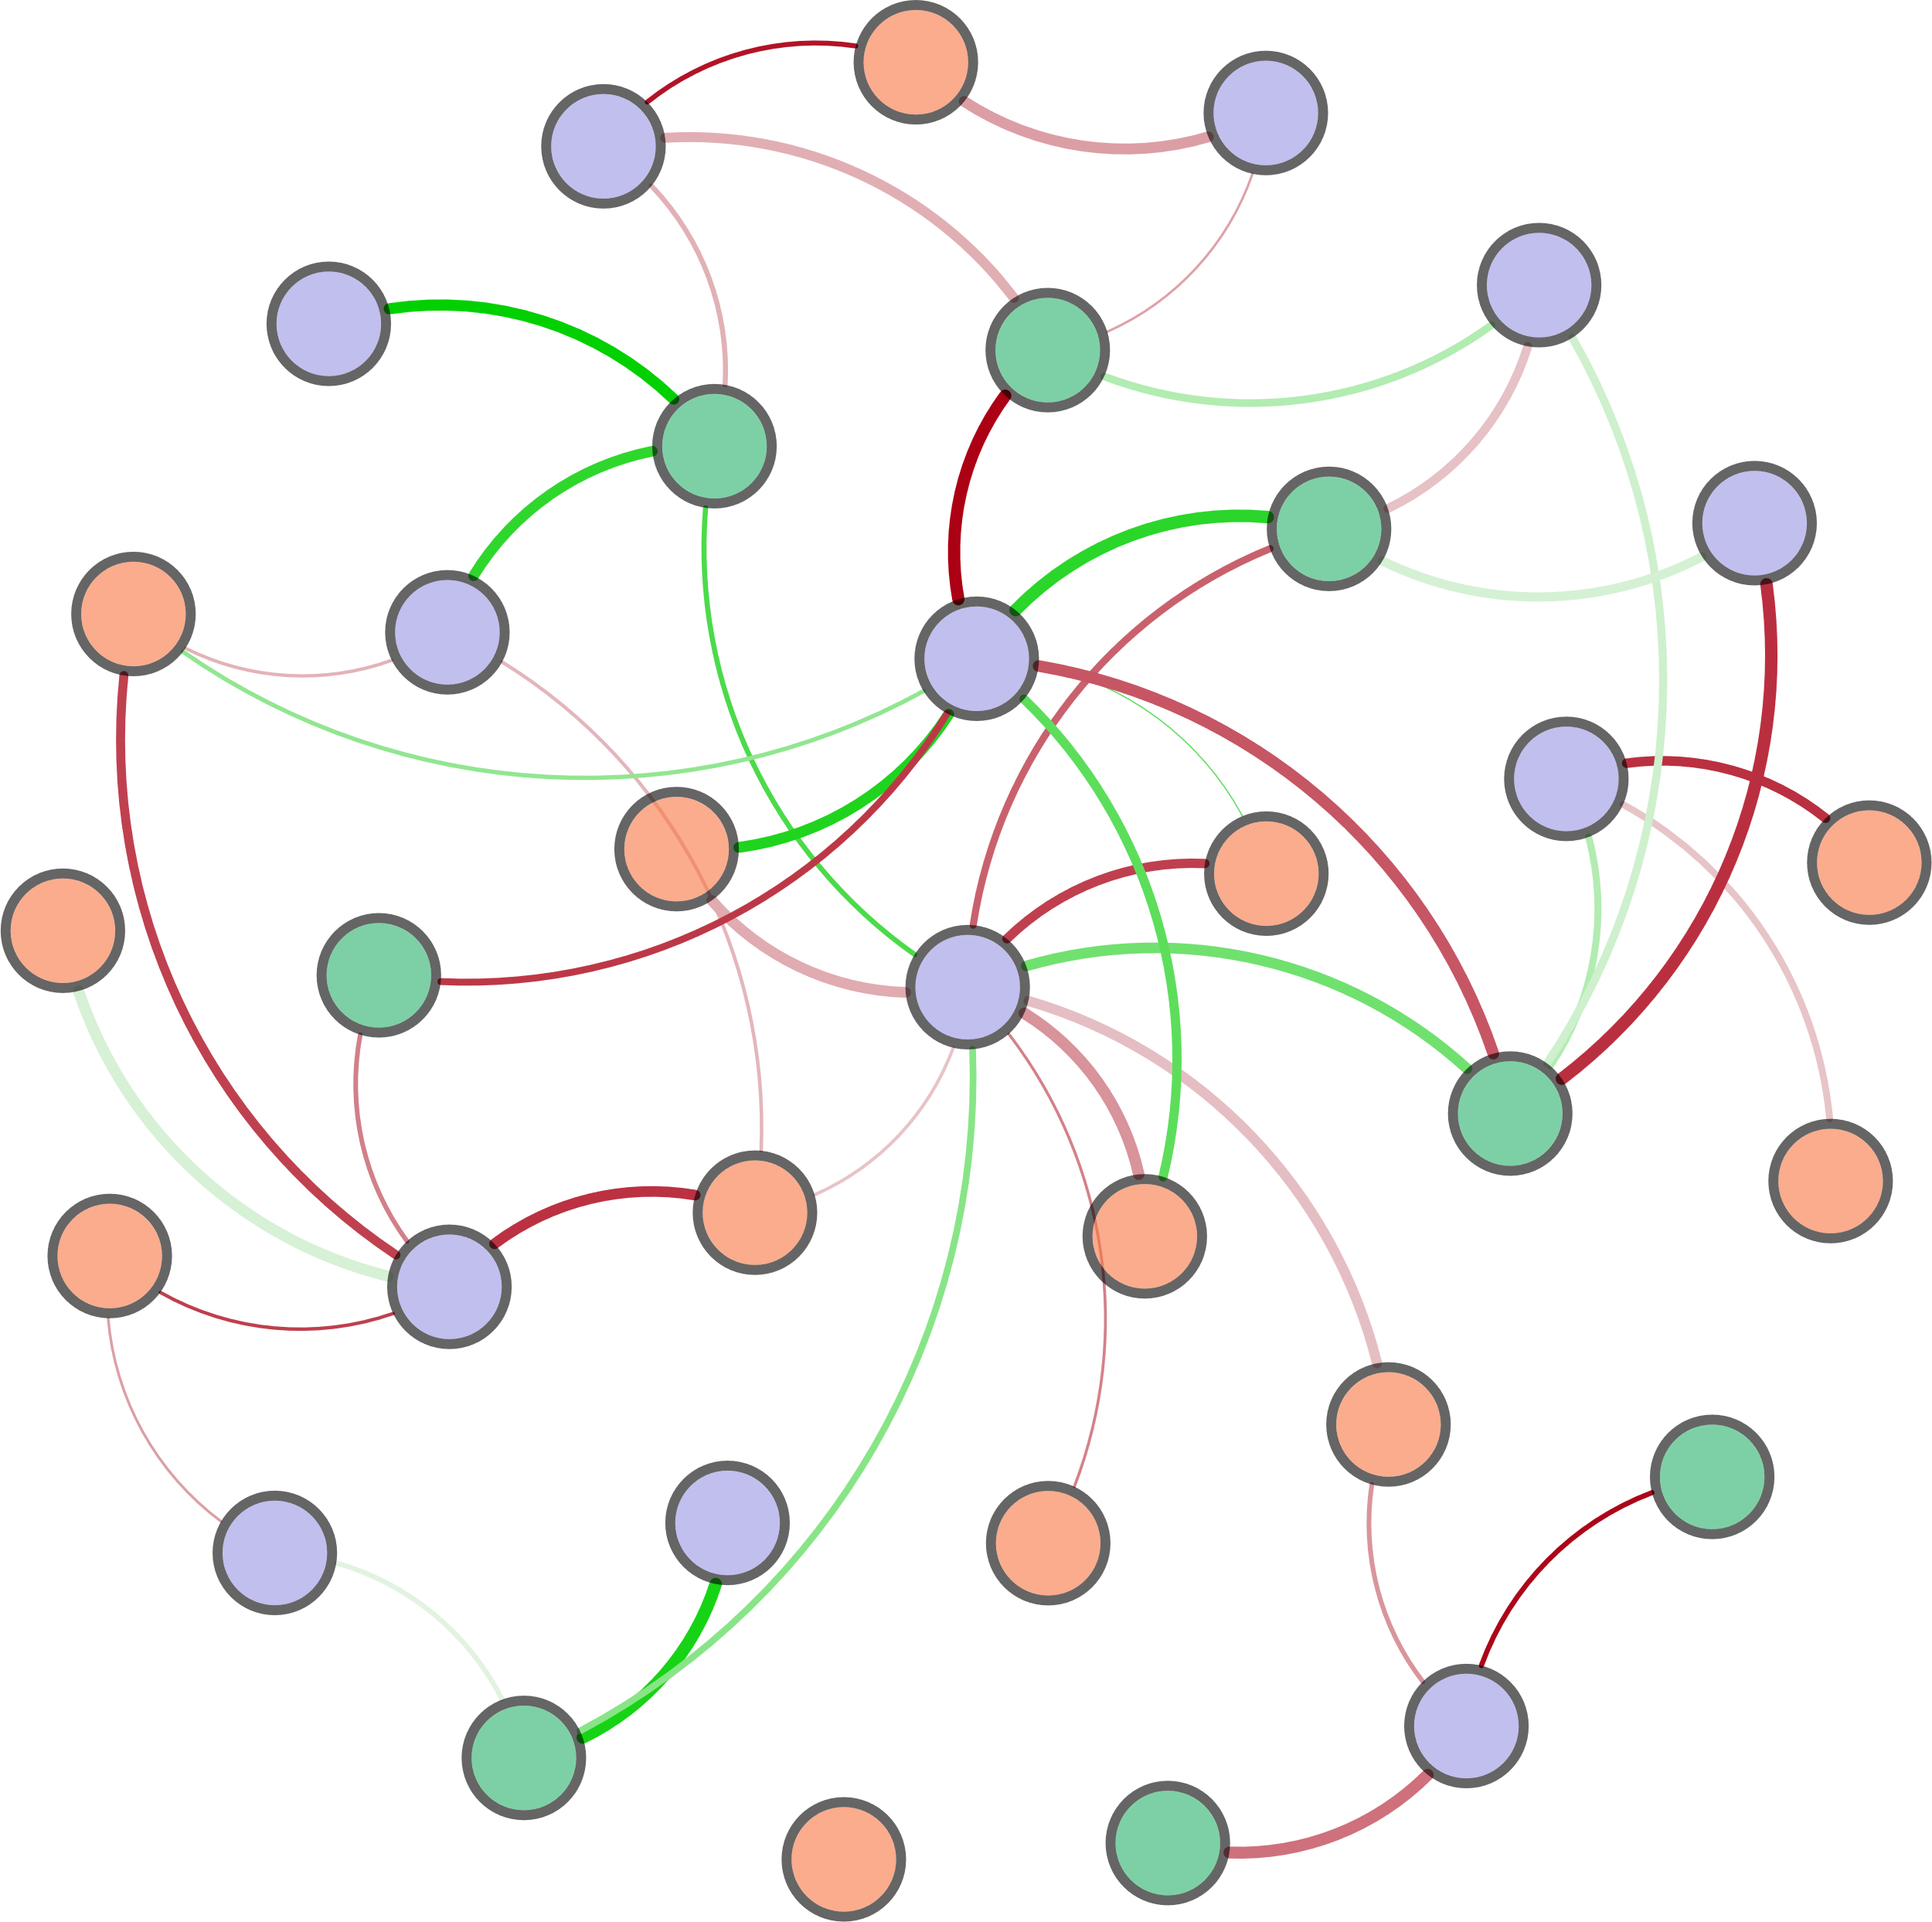
S-TN
nirK
Bacterial 16S rRNA
nirS
narG
pH
DO
hzsA
d_{0.5}
Archaeal 16S rRNA
hzo
TP
napA
Ⅱ-Area
Ⅰ-Area
Ⅴ-Area
β:α
W-TN
hzsB
d_{0.9}
Ⅲ-Area
d_{0.1}
Ⅳ-Area
nifH
(d_{0.9}-d_{0.1})/d_{0.5}
T
AOA_amoA
AOB_amoA
TP
nxrA
COD

Slide 12
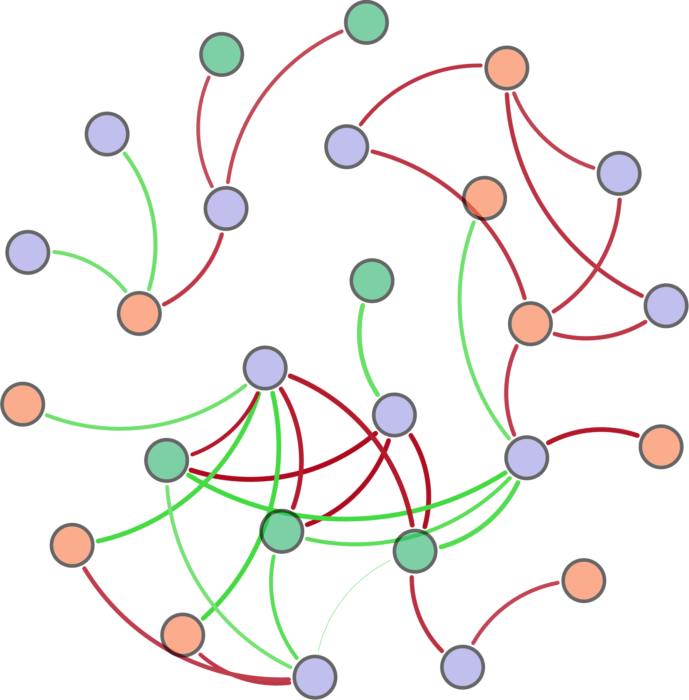
COD
Ⅲ-Area
nifH
Archaeal 16S rRNA
nirK
nxrA
Ⅰ-Area
narG
W-TN
FI
AOA_amoA
Ⅴ-Area
norB
HIX
Bacterial 16S rRNA
T
napA
TP
pH
d_{0.9}
DO
S-TN
d_{0.5}
hzo
hzsA

